Slide 1
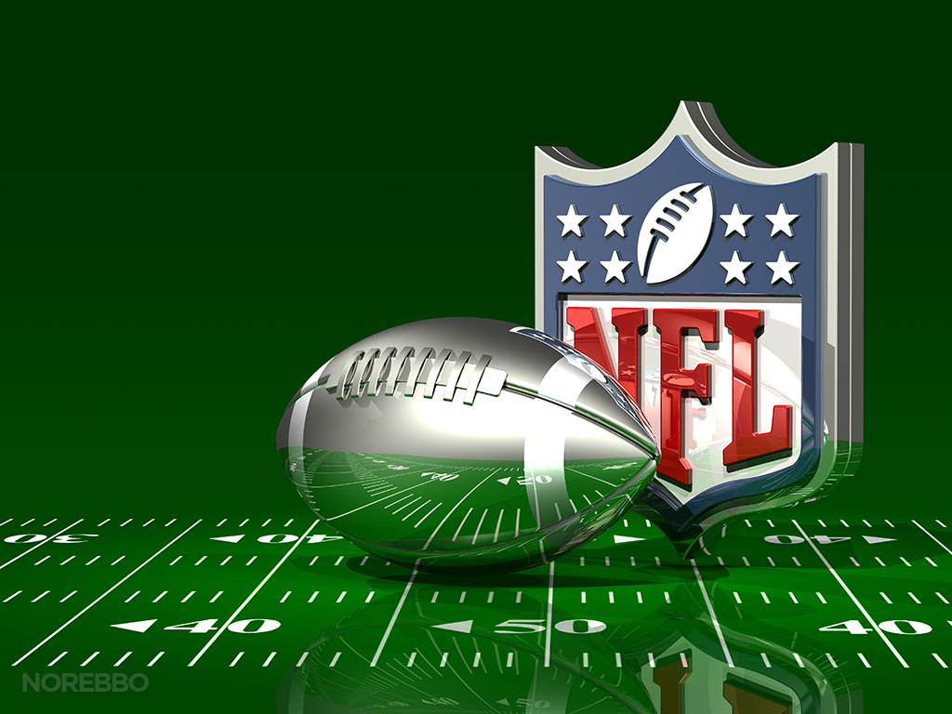
NFL Super Bowl Predictions
By: Carl Bent, Deron Porter, Chin Hsu, Otha Richardson ll

Slide 2
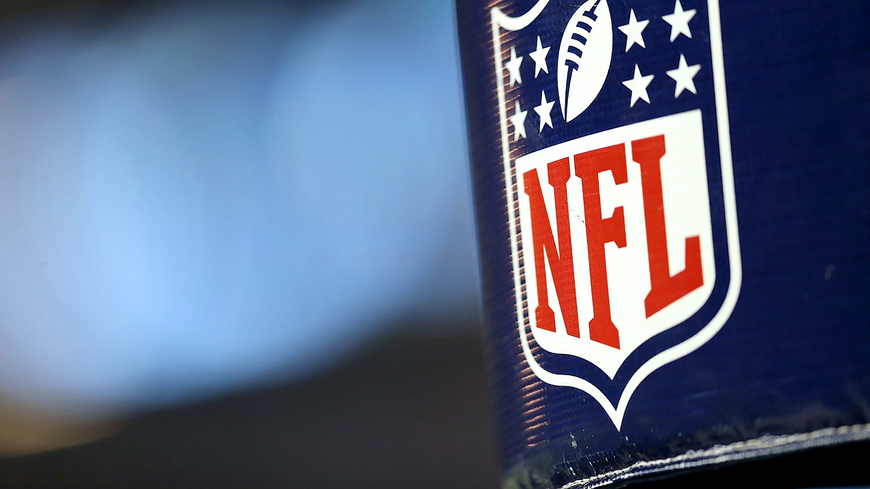
Executive Summary
The football industry is worth well over 15 billion dollars, and people use statistics to predict which team to invest in. These statistical processes are mostly commonly also used in fantasy football.
We have created an algorithm that will eliminate your time needed to research NFL statistics. You can actually sit back and enjoy the game, without worrying about the numbers.

Slide 3
Concept
Description:
A machine learning based algorithm that can predict the 2023 NFL Playoff contenders.
Motivation for development?
The need for accurate NFL data is constantly increasing
Easy to find open source data
User story
A user will be able to look at our algorithm, and be able to predict which team they want to invest in.

Slide 4
Data Techniques
Determined based off of these basic statistics
Number of wins per team
Net Points
Previous Super Bowl Wins
Reasoning for data selection
Utilizing the number of wins as a variable benefited us.
In the future we would add the amount of yards ran, passing, or even touch downs contribute to the number of wins a team has.
Collection, exploration and cleaning process.

Slide 5
Approach
Technologies used
Languages & Libraries: Python, Pandas, NumPy, Tensorflow, Sklearn, HvPlot, Pydotplus, and IPython
Platform: Amazon Web Services (Sagemaker), Jupyter lab, Excel, and Github.
Breakdown of tasks and roles
Otha Richardson ll- Data Research, Decision Tree, and logistic regression.
Chin Hsu- Data Research, logistic regression, and clustering
Deron Porter- Data Research, and deep learning
Carl Bent- Data Research, and Powerpoint Presentation
Challenges
It became difficult to include more data in our model because of timing.
Displaying the results in a human readable form
Successes
It was really easy to find open source data

Slide 6
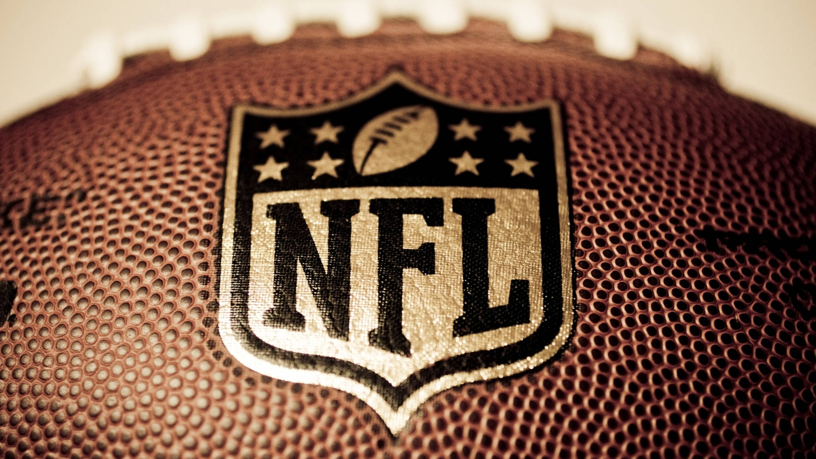
Project #2 Demo

Slide 7
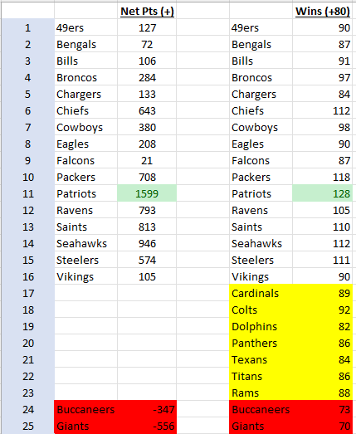
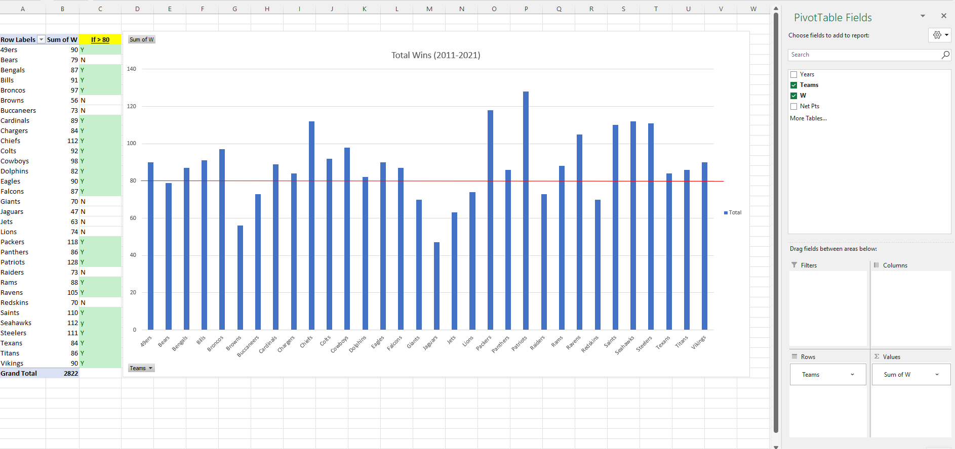
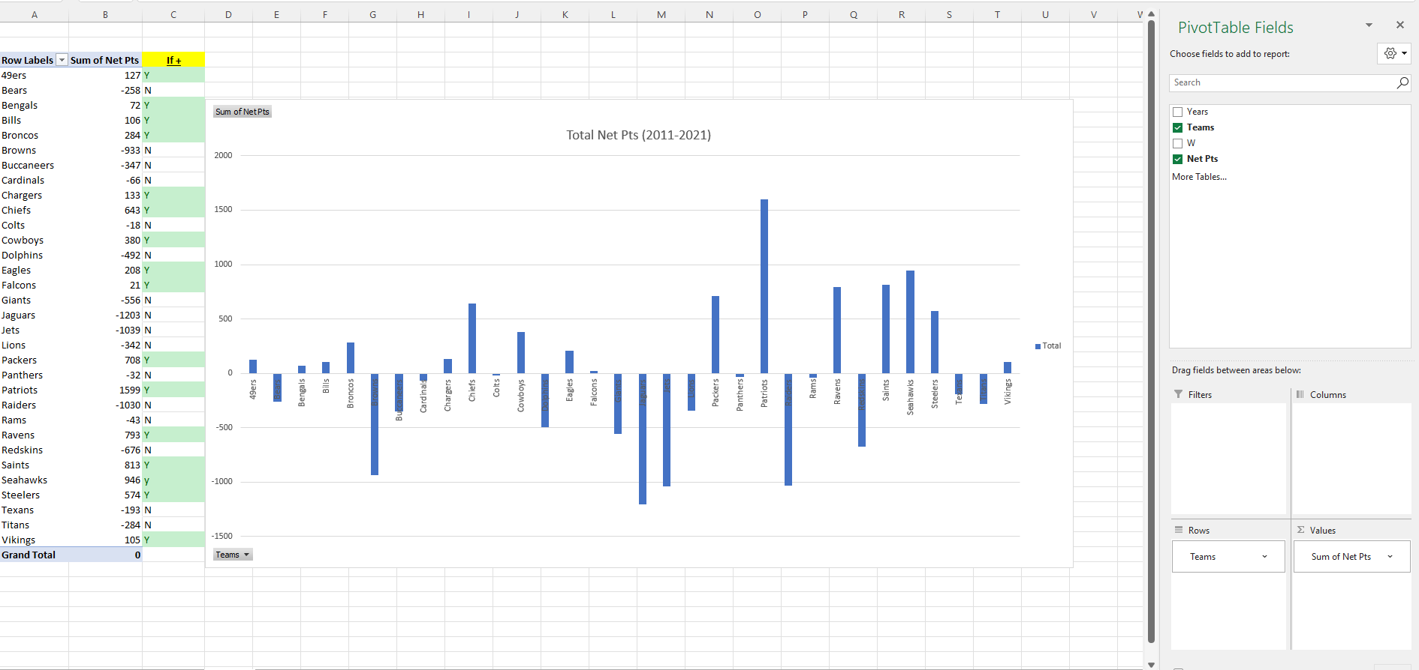
Preliminary Analysis - MS Excel (2011-2021)
‘Net Points’ is the biggest predictor for wins.
https://github.com/kingdee60/Project_2_SuperBowlPrediction/blob/main/Resources/Super%20Bowl%20Analysis.xlsx

Slide 8
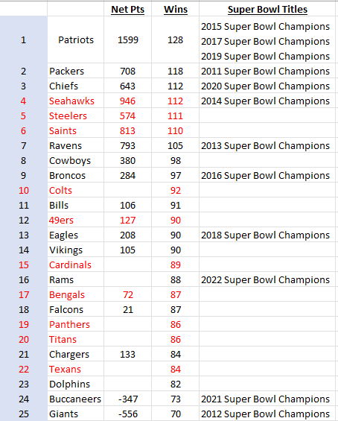
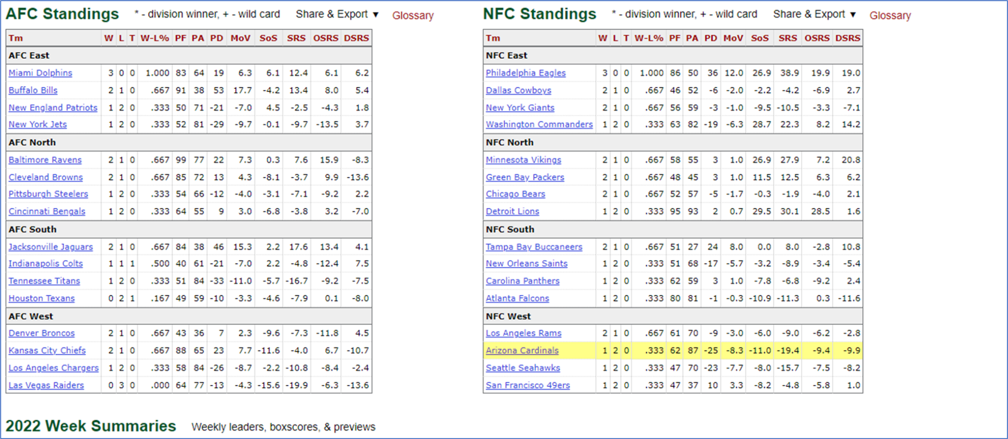
Preliminary Analysis - Current Data & SuperBowl History
** Added SuperBowl History (0 or 1), current standings considerations, and qualitative information (ie Tom Brady transfer to Buccaneers…Russell Wilson to Broncos…Rams 2022 SuperBowl Winners)

Slide 9
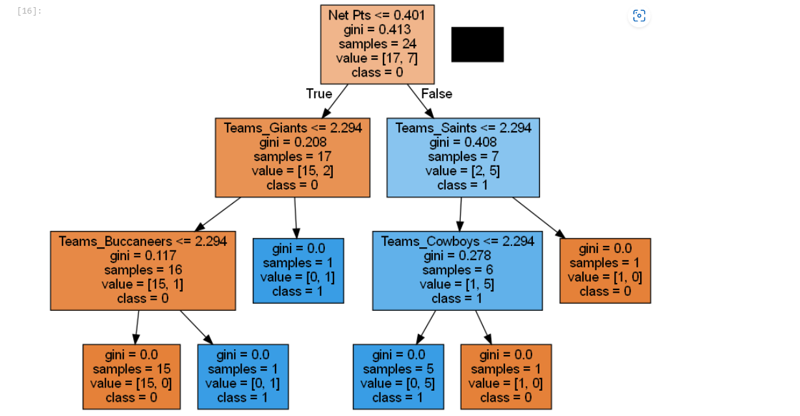
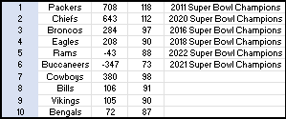
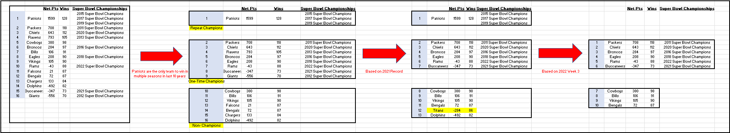
Preliminary Analysis - Decision Tree
** Removed New England Patriots as the outlier. They are the ONLY NFL Team with multiple wins in the last decade.

Slide 10
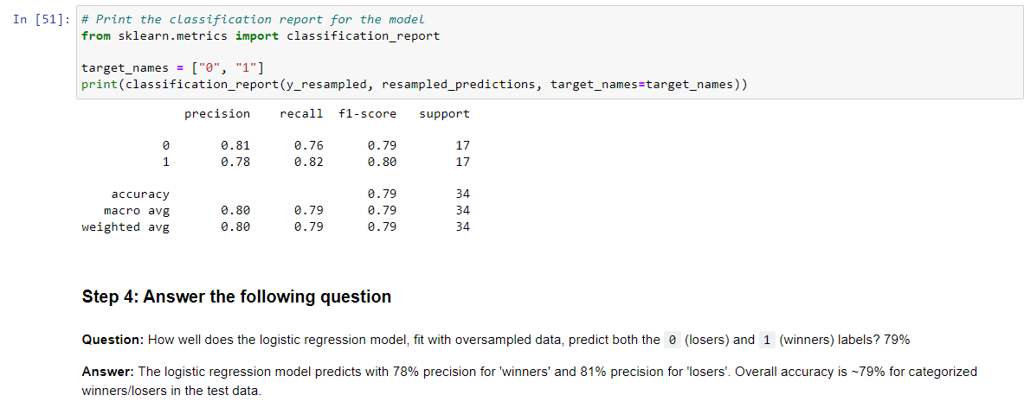
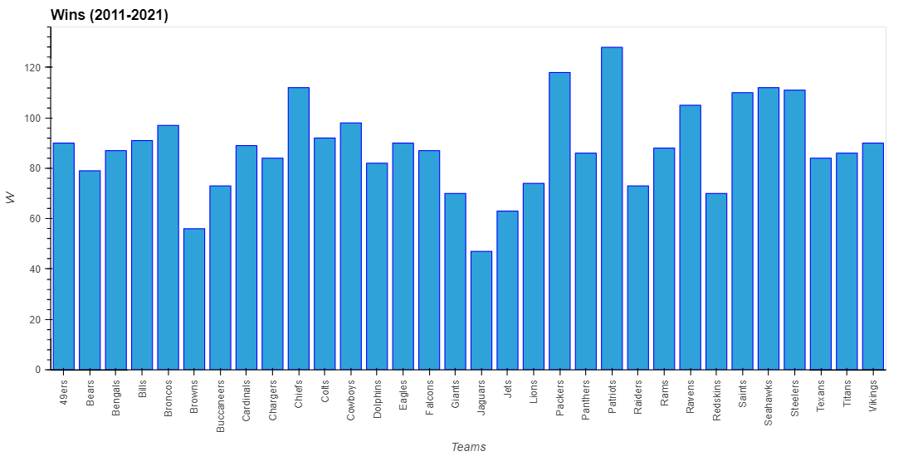
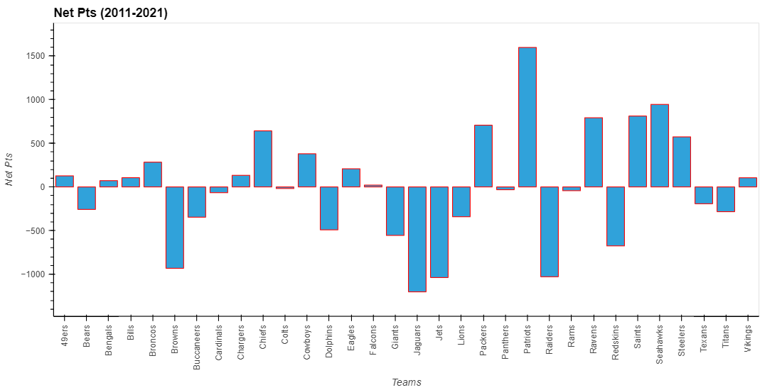
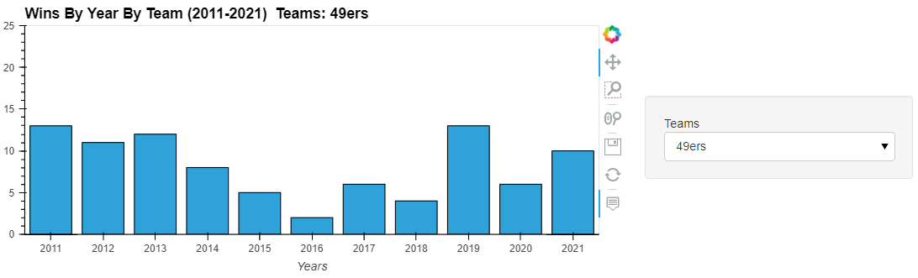
Data - Logistic Regression

Slide 11
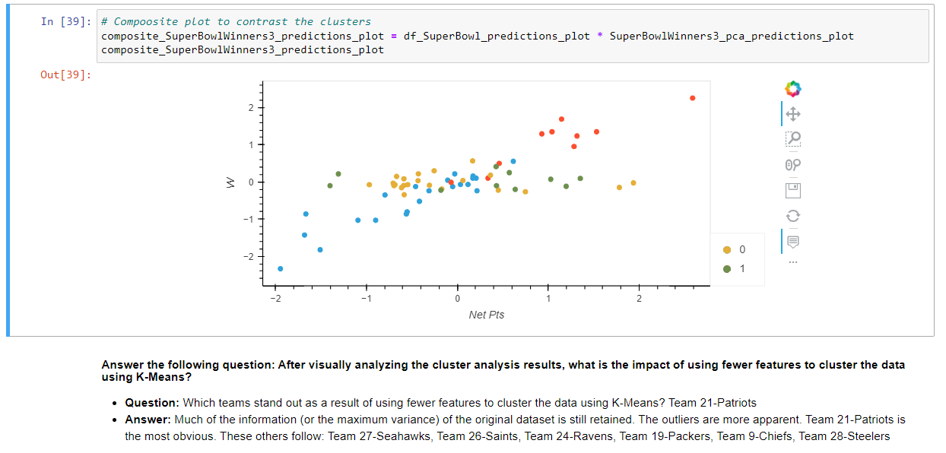
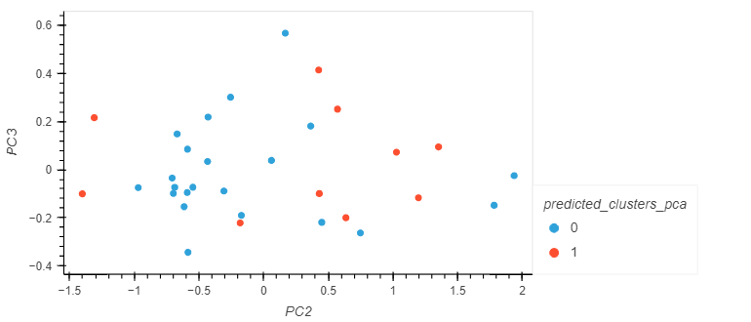
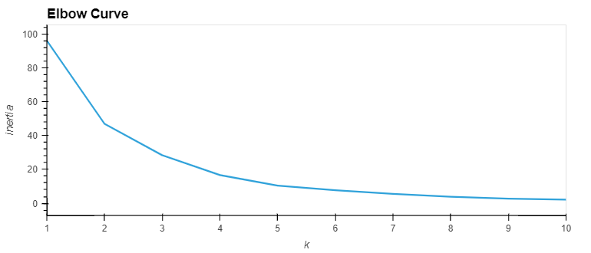
Data Continued- Clustering

Slide 12
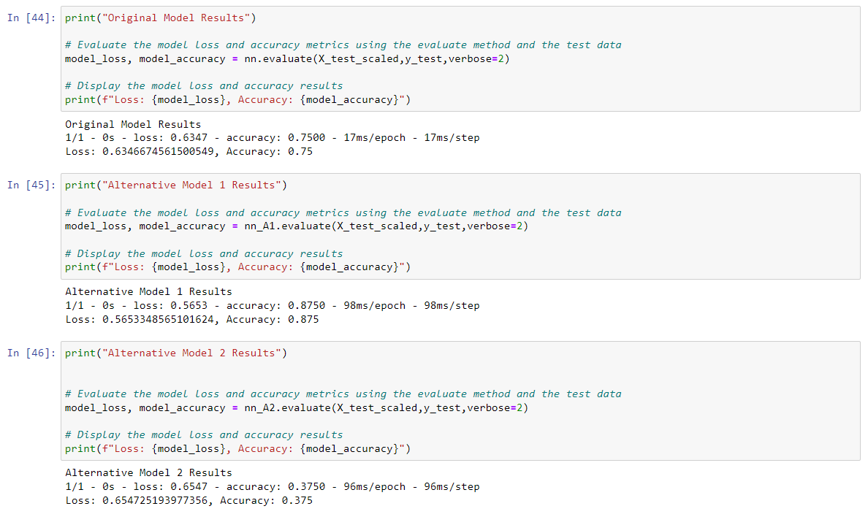
Data Continued- Deep Learning

Slide 13
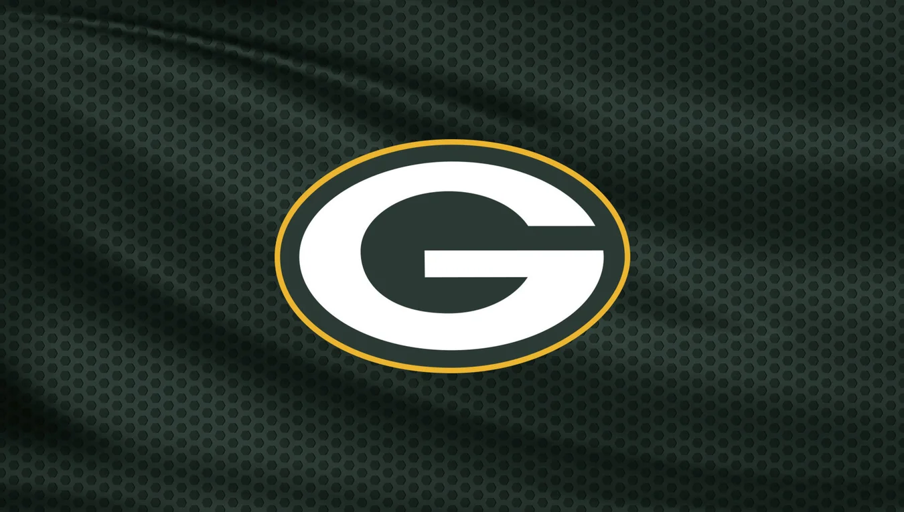
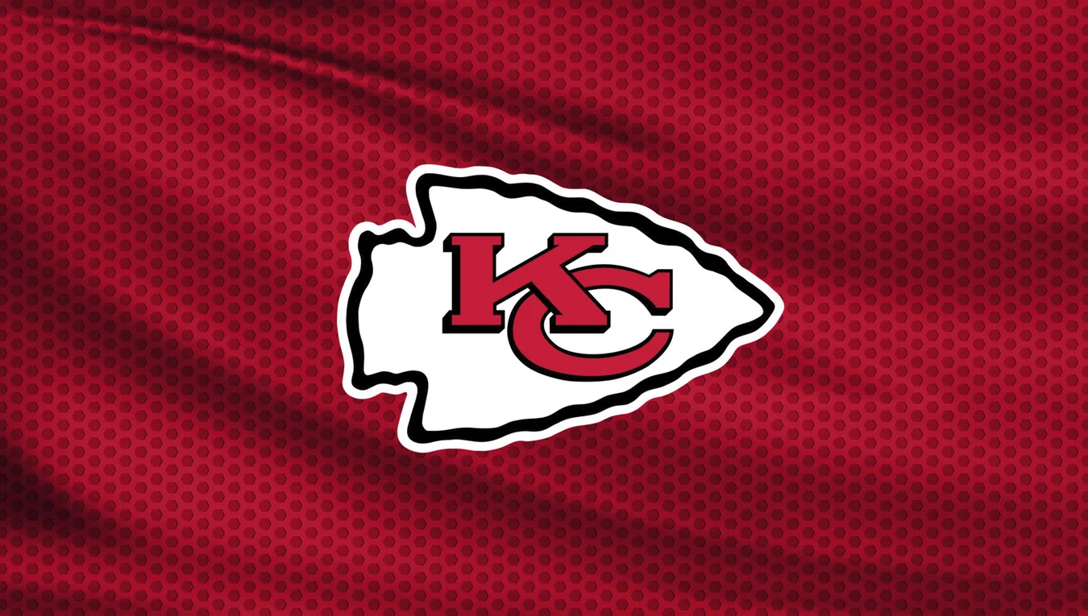
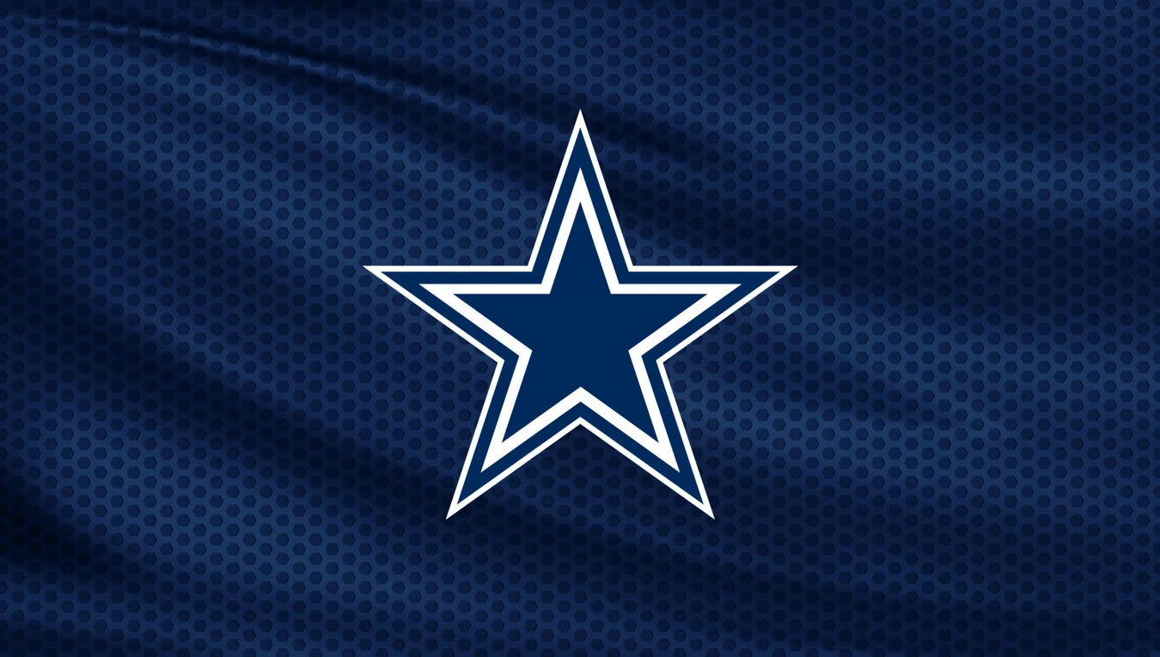
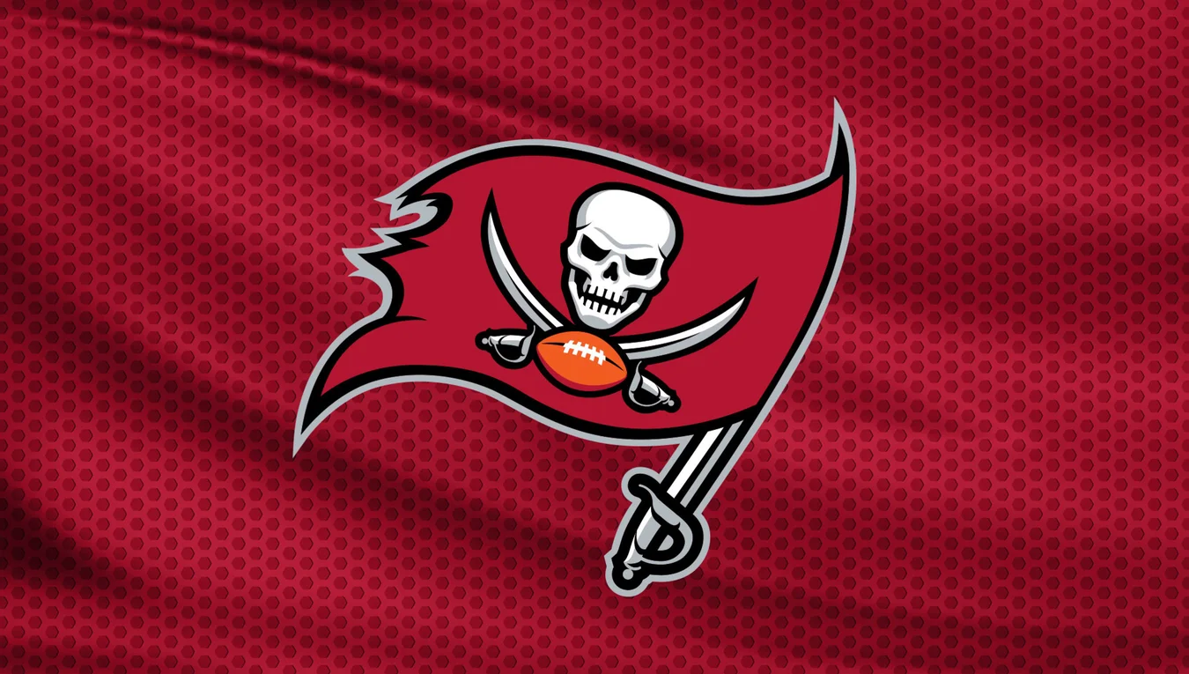
SuperBowl Predictions

Slide 14
Next Steps
Additional questions that surfaced.
What will predictive analytics in fantasy football look like in 5-10 years from now?
What limitations will the government add to this in the future?
Additional topics to research.
Creating additional algorithms to add to our model using:
Receiving, passing, touchdowns, tackles, fumbles, interceptions
Plan for future development.
To go more in depth with our algorithm and to add one for each current player.

Slide 15
Links
Works Cited
Deployed application.
Github Repository
Interactive Poll
https://poll-maker.com/poll4500246xb2114683-141
National Football League- (NFL)
https://www.nfl.com/stats/team-stats/
https://www.nfl.com/standings/
https://www.pro-football-reference.com/

